Slide 1
Tesla Motors
Presentation made by: Nikolay Sinorov

Slide 2
Introduction
In this section what I’m about to tell you:
- What is Tesla?
- Who is the creator of Tesla?
- When and where it was invented?

Slide 3
What is Tesla?
Tesla is an American electric vehicle and clean energy company based in Palo Alto, California.
The company specializes in electric vehicle manufacturing and battery energy storage.
Tesla is aiming to offer electric cars at prices affordable to the average consumer.
In February 2017, Tesla Motors shortened its name to Tesla.

Slide 4
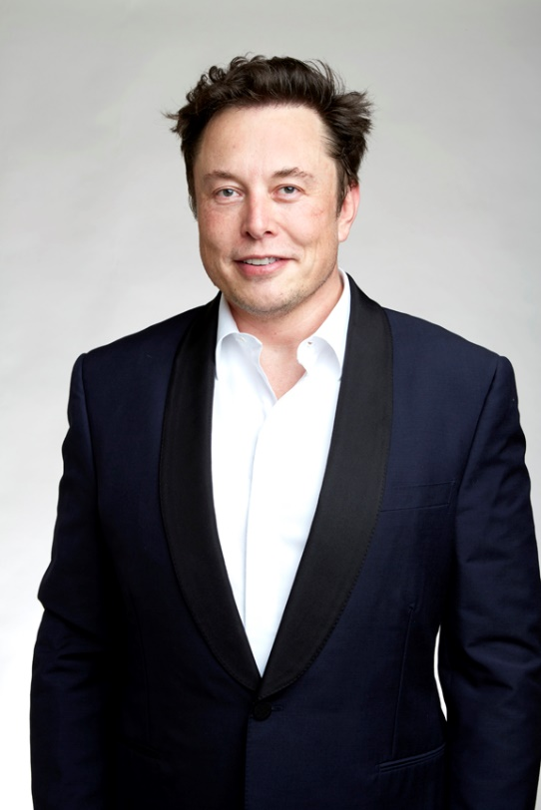
Who is the creator of Tesla?
The idea and the creation of the company is by the engineers Martin Eberhard and Marc Tarpenning.
The company's name is a tribute to inventor and electrical engineer Nikola Tesla.
The next three employees were Ian Wright, Elon Musk, and J. B. Straubel. The CEO of the company is Musk.

Slide 5
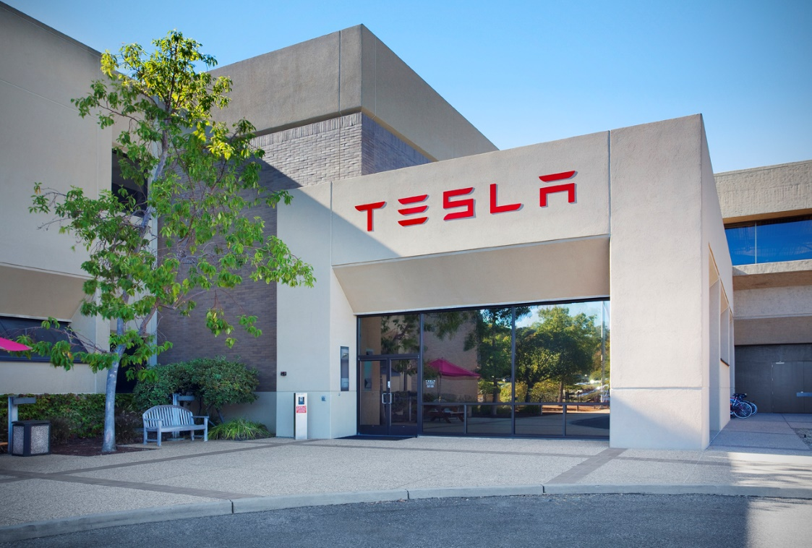
When and where it was invented?
Tesla HQ in Palo Alto
Tesla was founded in July 2003.
The first factory was built in California, near Reno
Its main vehicle manufacturing facility at Tesla Factory are in Fremont, California; Giga Nevada near Reno, Nevada; Giga New York in Buffalo, New York; and Giga Shanghai in Shanghai, China.

Slide 6
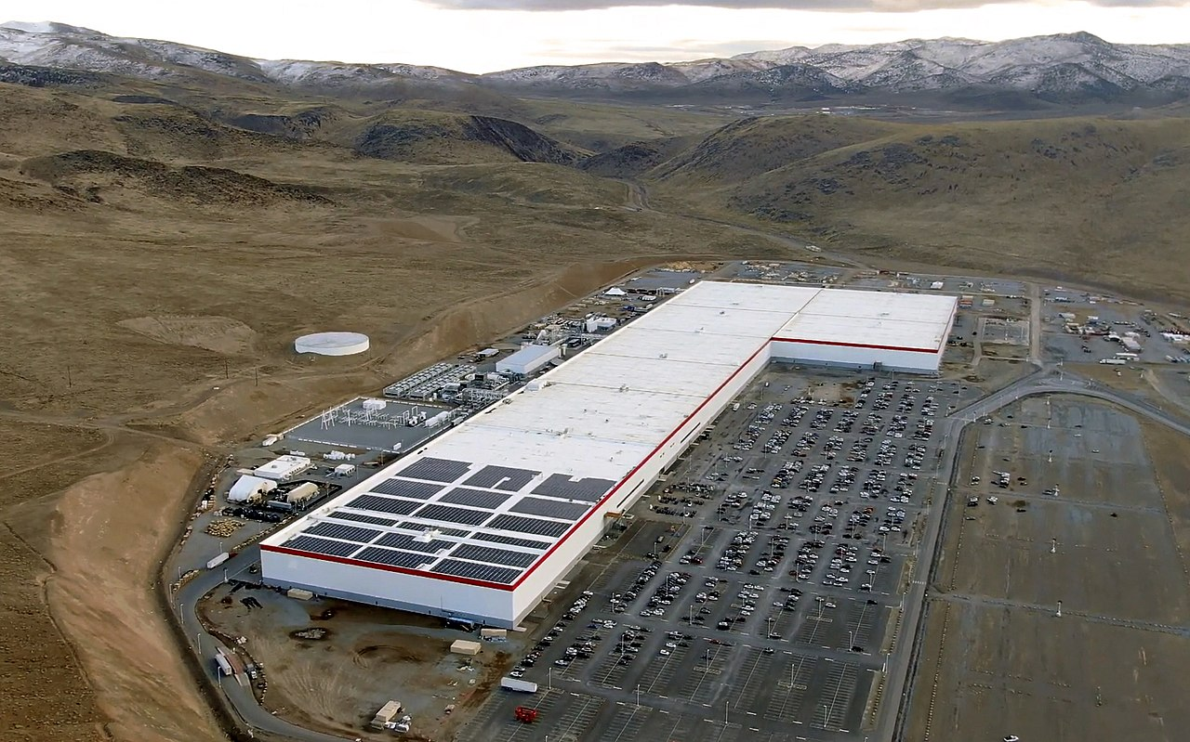
Tesla construction
Fremont, Nevada

Slide 7
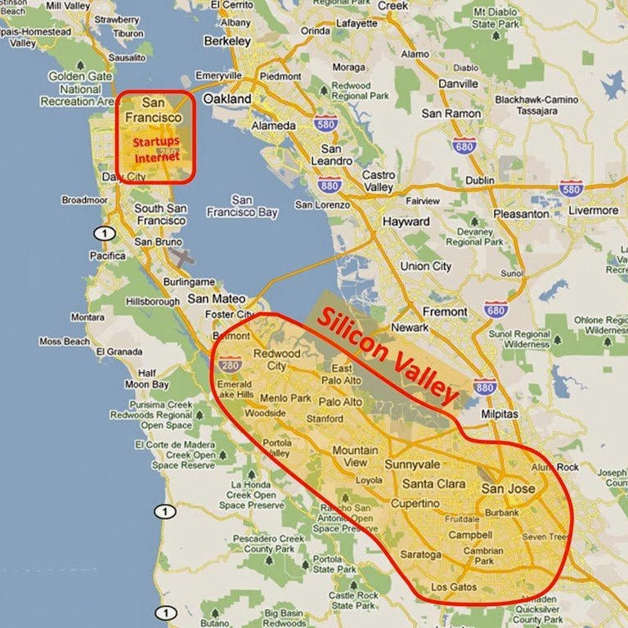
Palo Alto and Silicon Valley on the map

Slide 8
Main body of the presentation
In this section what I’m about to tell you:
- How and why Tesla was created?
Will the business grow?
How much does it cost to build an electric car
- We will take a look at the Tesla models: “S”, “3”
“X”, “Y” and the last “Cybertruck”.

Slide 9
How and why Tesla was created?
How? Musk loves physics and he was inspired by Nikola Tesla and so he and others engineeners gathered and wanted just to change the automobile world. Tesla has never had a profitable year until September 2018! They were having so much issues about every component on the car and were in huge debts.
Why? Musk believes that the world needs to move towards a zero-emission future.

Slide 10

Will the business grow?
Early I said that Tesla never had a profitable year until 2018 but right now on 20 February 2020, Tesla reached a market capitalization of $166 billion.
From 2 years, Tesla sale’s have increased so much and will continue to grow.
Every model is greater than the previous model, and
every car is focused to be in personal use.

Slide 11
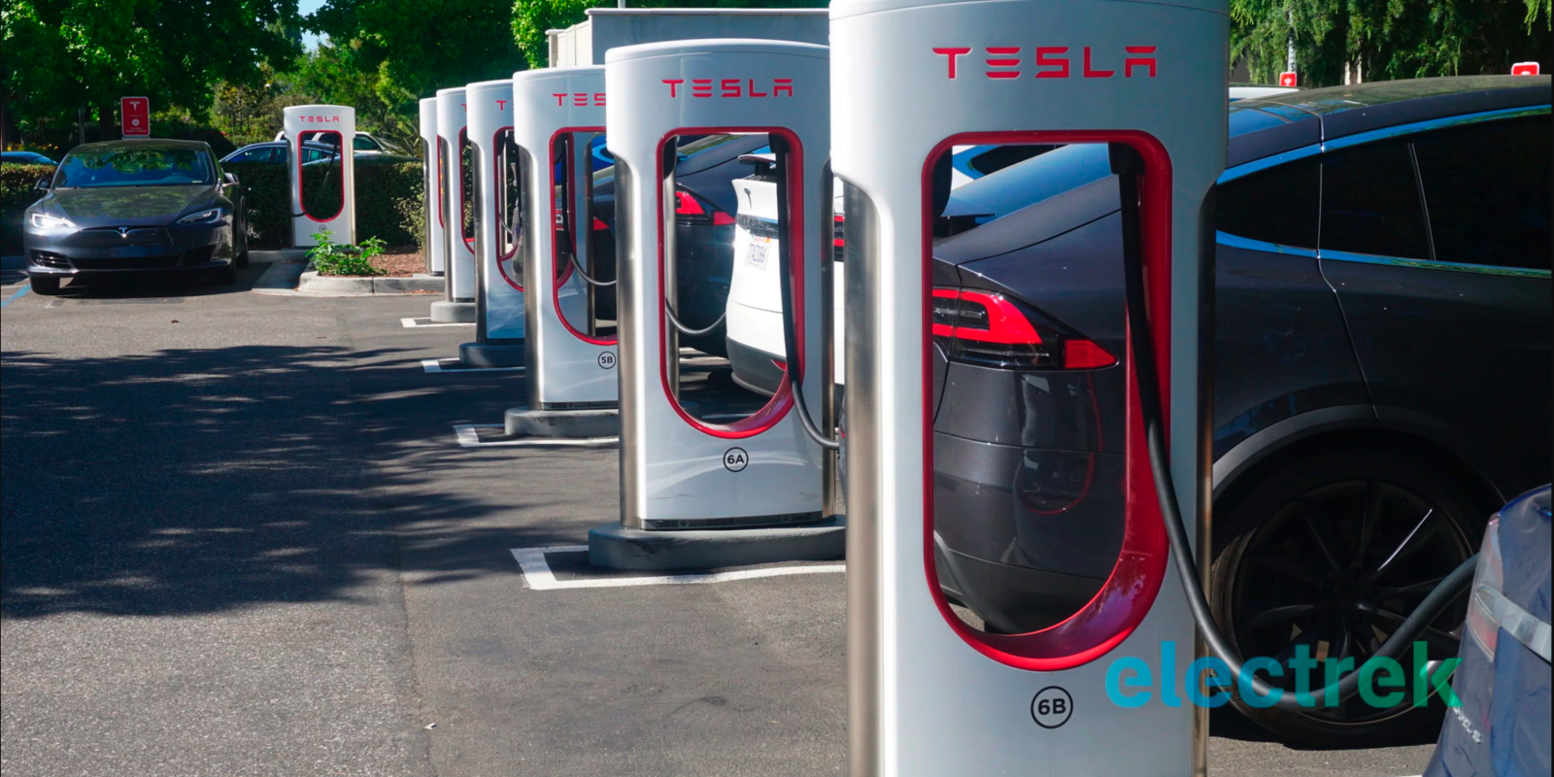
Tesla have placed “Tesla superchargers” stations of all over the globe, so that people can charge their cars when they are on the road.
For FREE!

Slide 12
Tesla at the moment is the best electric car.
Engineers have made the company to be brilliant. The car have so much extras such as: Super charging and to cross over 400km for just one charge; autopilot – the car drives on its own, using integrated cameras, 360 degree sensors, big tablet to optimize your Tesla for your personal use; Great style; affordable prize for such a car.

Slide 13
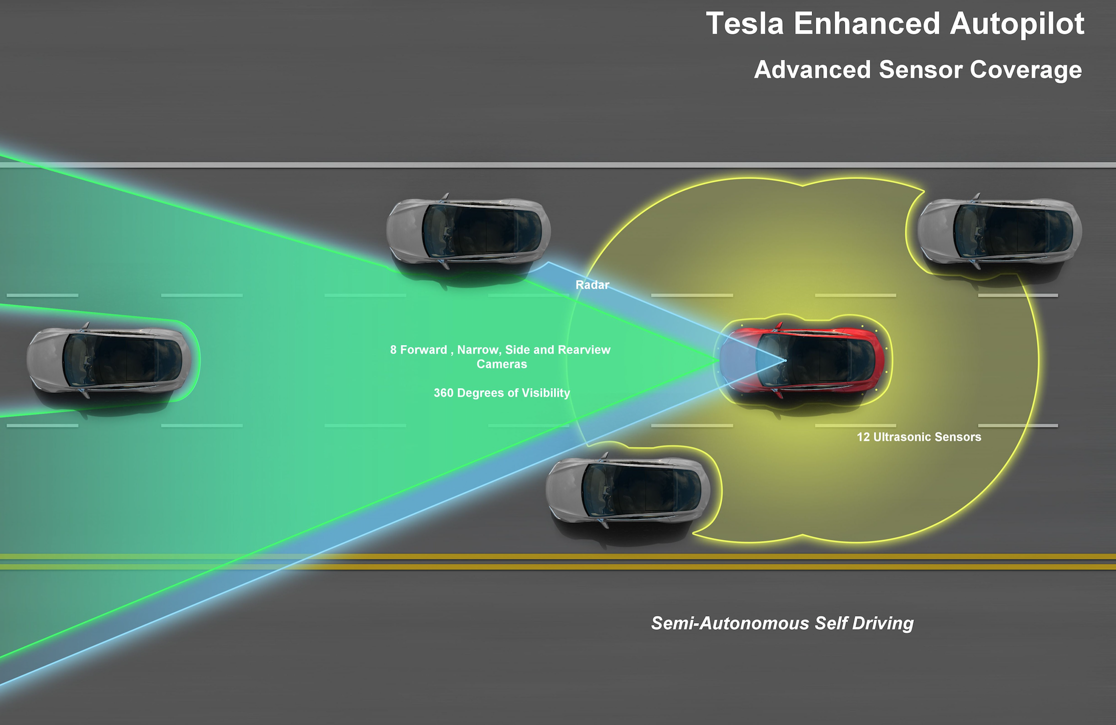
Tesla’s autopilot

Slide 14
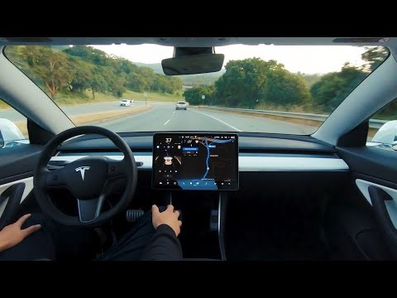

Slide 15
How much does it cost to build an electric car ?
The lowest price Tesla can sell you such a car is 30 000 dollars in USA.
As I said early it’s a personal use car, before you buy the car, you design it! You choose the model and all the extras the company can give you.
And so approximately the normal price is starting from
70 000 dollas to 130 000.

Slide 16
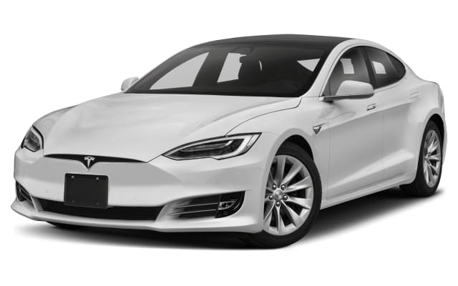
Let’s take a look at the Tesla models Tesla Model S

Slide 17
Tesla Model S
- Go anywhere with up to 391 miles of range on a single charge.
- Recharge up to 136 miles in 15 minutes at any Supercharger location.
- Model S is built with best in class storage, seating for up to five adults and an expansive 17-inch touchscreen.
- The quickest acceleration on earth—from zero to 60 mph in as little as 2.3 seconds.

Slide 18
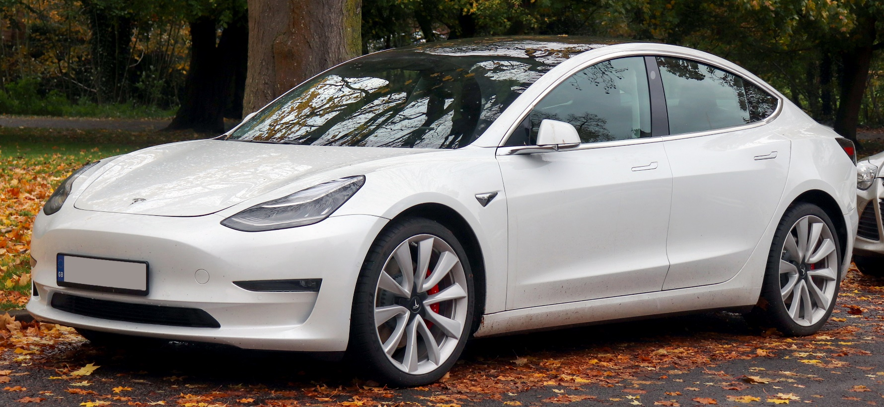
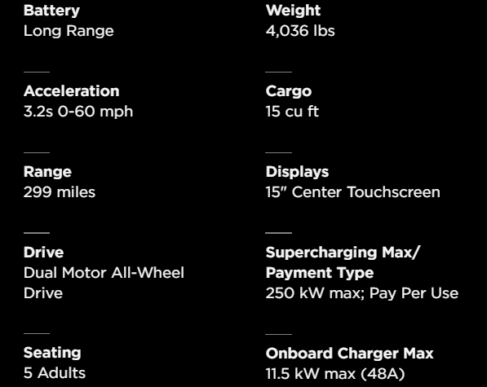
Tesla model 3
- Compact size
- metal structure is a combination of aluminum and steel, for maximum strength in every area.

Slide 19
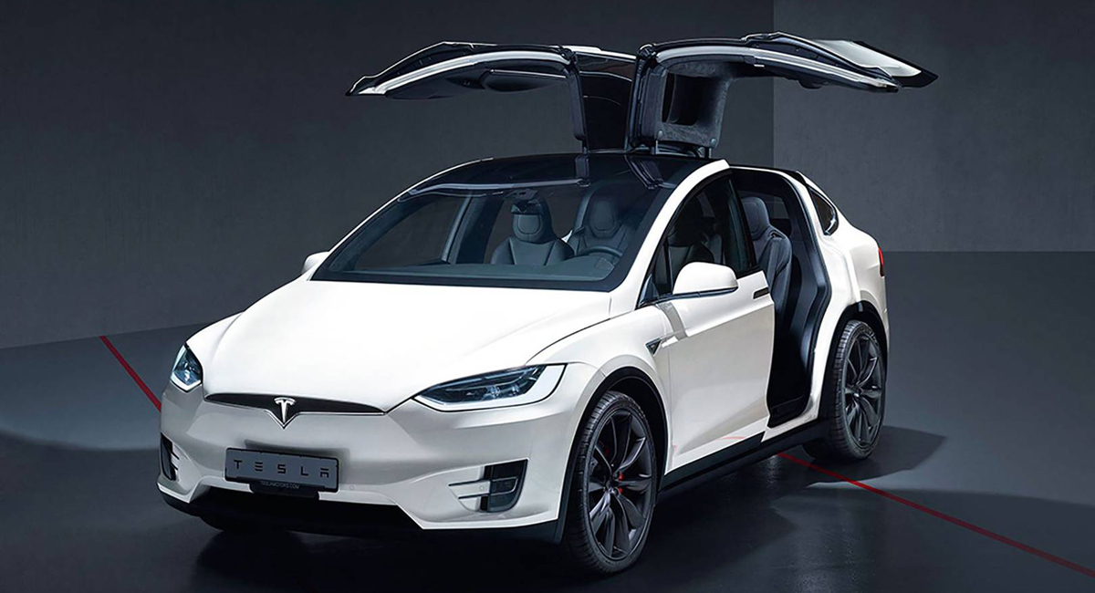
Tesla model X
5 star safety
7 max passangers and cargo
2.6s from 0 to 60 mph.
20’’, 22’’
Model X is one of the safest SUVs ever.
Model X is built to provide the most convenient interior experience ever—with best in class storage

Slide 20
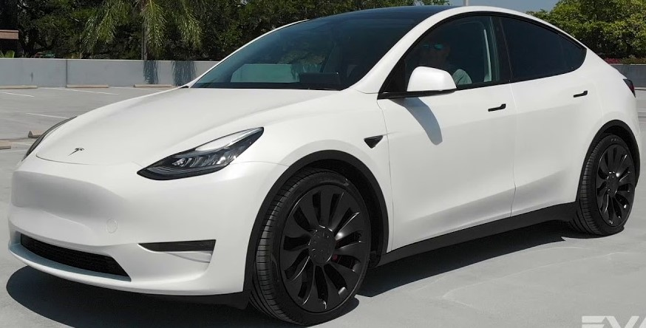
Tesla model Y
3.5s from 0 to 60 mph.
Again max safety for this class
Max 7 passengers
316 miles for 1 full charge
It is the second vehicle based on the Model 3 sedan platform
Y is the small version of the X model.

Slide 21
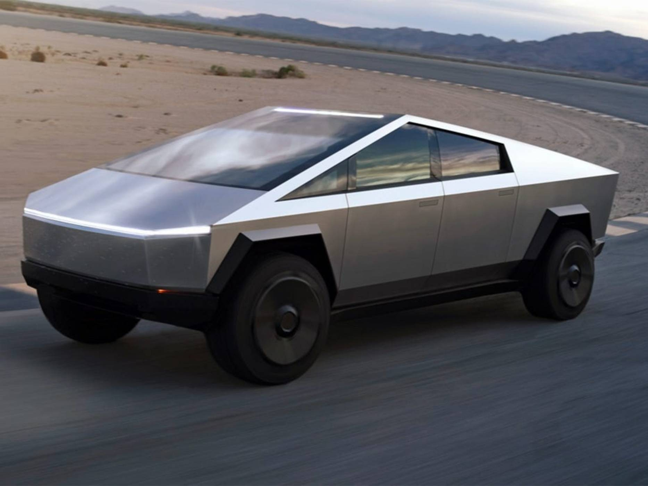
Cybertruck

Slide 22
- Cybertruck is built with an exterior shell made for ultimate durability and passenger protection. Starting with a nearly impenetrable exoskeleton, every component is designed for superior strength and endurance, from Ultra-Hard 30times Cold-Rolled stainless-steel structural skin to Tesla armor glass.
- Ultra-strong glass and polymer-layered composite can absorb and redirect impact force for improved performance and damage tolerance.
Innovative

Slide 23
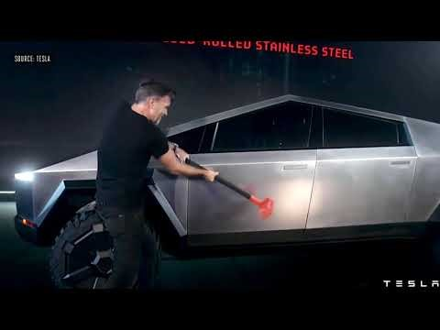

Slide 24
Conclucion
-What you need to know before you buy this type of vehicle.
-Is it worth it to buy a Tesla?

Slide 25
What you need to know before you buy this type of vehicle.
It’s electric, not a gas car. There isn’t negative feedbacks from people that have bought such a car. Well maybe few, but the company is taking full responsibility and fix the problem. They might forget to put the “Tesla bag” in your car. As said early every model is for personal use, and roads. Super comfort, speed, innovation, style, fast charging, safety.

Slide 26
Is it worth it to buy a Tesla?
With the potential for lower insurance rates, in addition to being eco-friendly and loaded with great features, many may just find Tesla worth the cost.
The vehicles are luxury cars

Slide 27
Thanks for the attention!
-Musk is very thankful to Nikola Tesla

